Slide 1
Bluestock Mutual Fund Analytics Capstone
Prepared By: Unnimaya V Ashok
Date: June 2026

Slide 2
Problem Statement & Objectives
Problem Statement:
Mutual fund investors generate large volumes of performance and transaction data that require systematic analysis to support informed investment decisions.
Objectives:
• Build an ETL pipeline for mutual fund datasets
• Perform Exploratory Data Analysis (EDA)
• Compute financial performance metrics
• Develop an interactive Power BI dashboard
• Perform advanced risk analytics
• Build a fund recommendation system

Slide 3
Data Sources
Datasets Used:
NAV History Dataset
  Daily Net Asset Values
AUM Dataset
  Assets Under Management
Scheme Performance Dataset
  Returns and risk metrics
Investor Transactions Dataset
  SIP, Lumpsum, and Redemption transactions
Purpose:
To analyze fund performance, investor behavior, and market trends.

Slide 4
Project Architecture
Workflow:
Raw CSV Data
↓
ETL Pipeline
↓
Data Cleaning & Processing
↓
Exploratory Data Analysis
↓
Performance Analytics
↓
Advanced Analytics
↓
Power BI Dashboard
↓
Insights & Recommendations
Tools Used:
Python → SQLite → Power BI

Slide 5
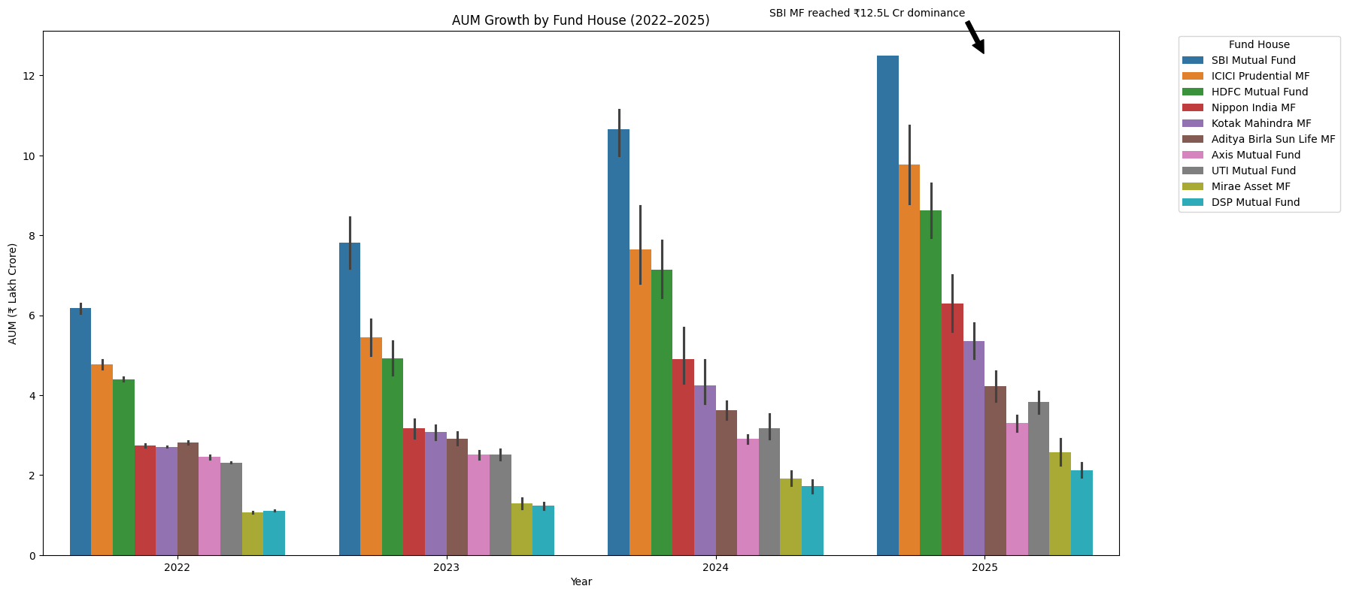
EDA Highlights
Key Insights:
• Large AMCs manage a significant portion of industry assets.
• Asset distribution is concentrated among leading fund houses.
• AUM varies significantly across categories.

Slide 6
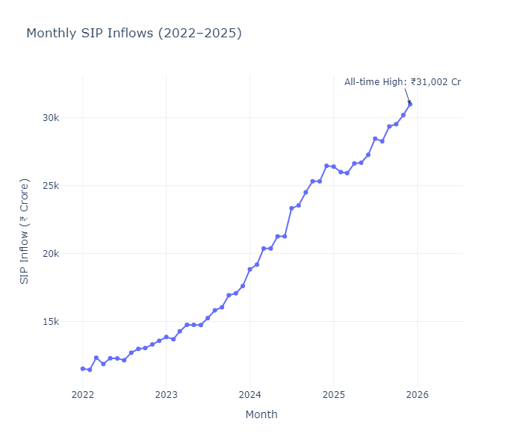
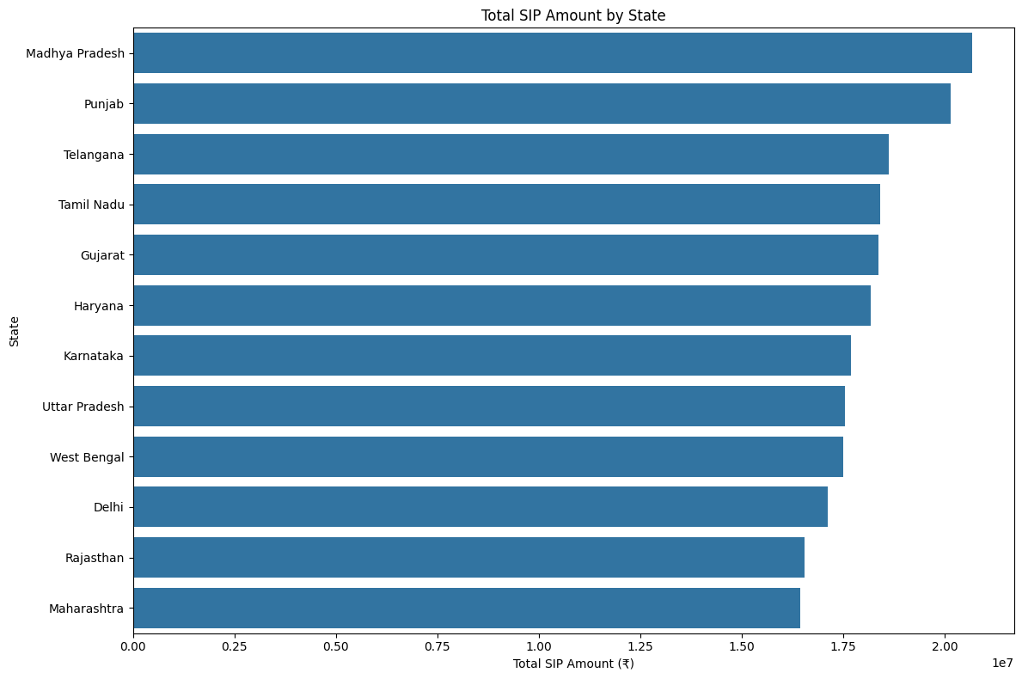
EDA Highlights

Slide 7
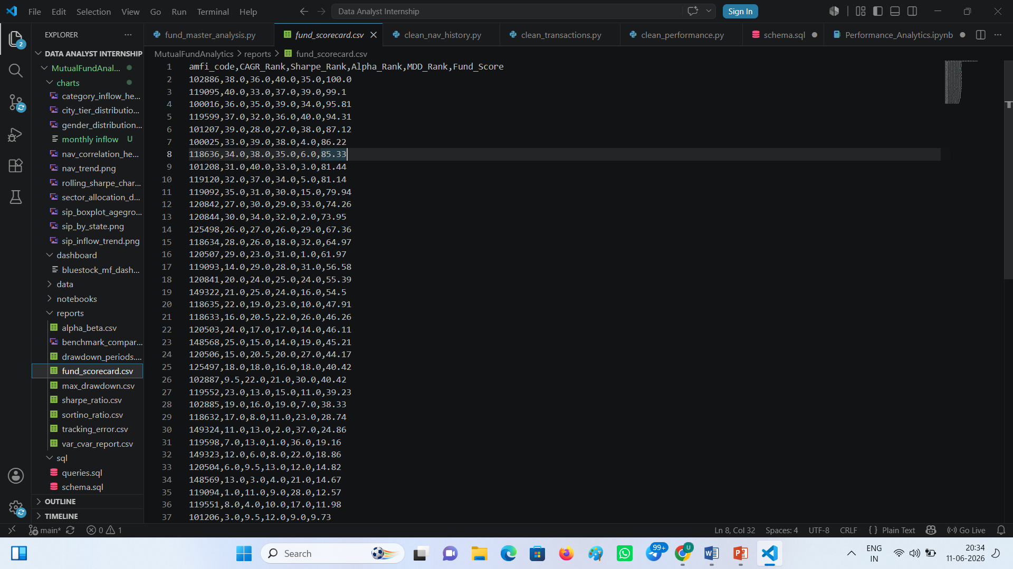
Performance Analytics
Metrics Computed:
• CAGR
• Sharpe Ratio
• Sortino Ratio
Key Findings:
• Several funds delivered strong risk-adjusted returns.
• Sharpe Ratio helped identify efficient funds.
• Sortino Ratio highlighted downside-risk performance.

Slide 8
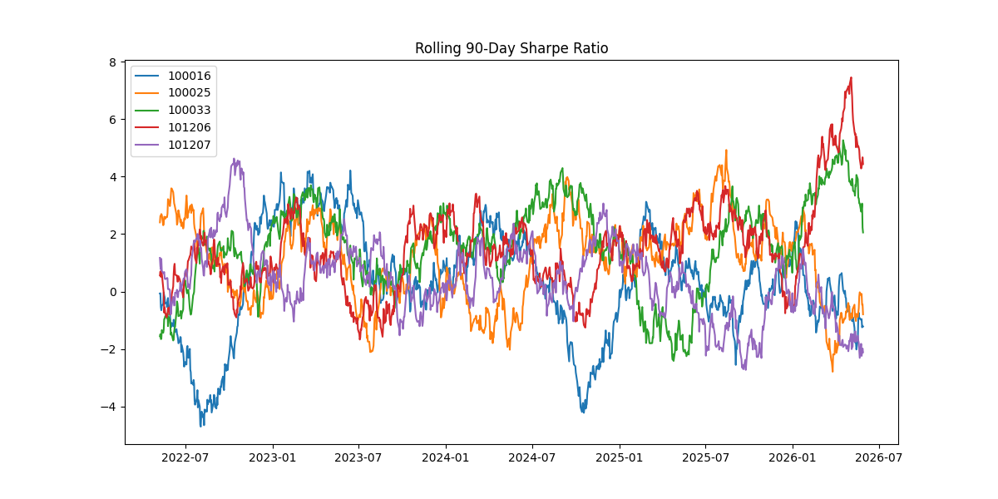
Advanced Analytics
Key Insight:
Higher VR funds demonstrated greater downside risk exposure.

Slide 9
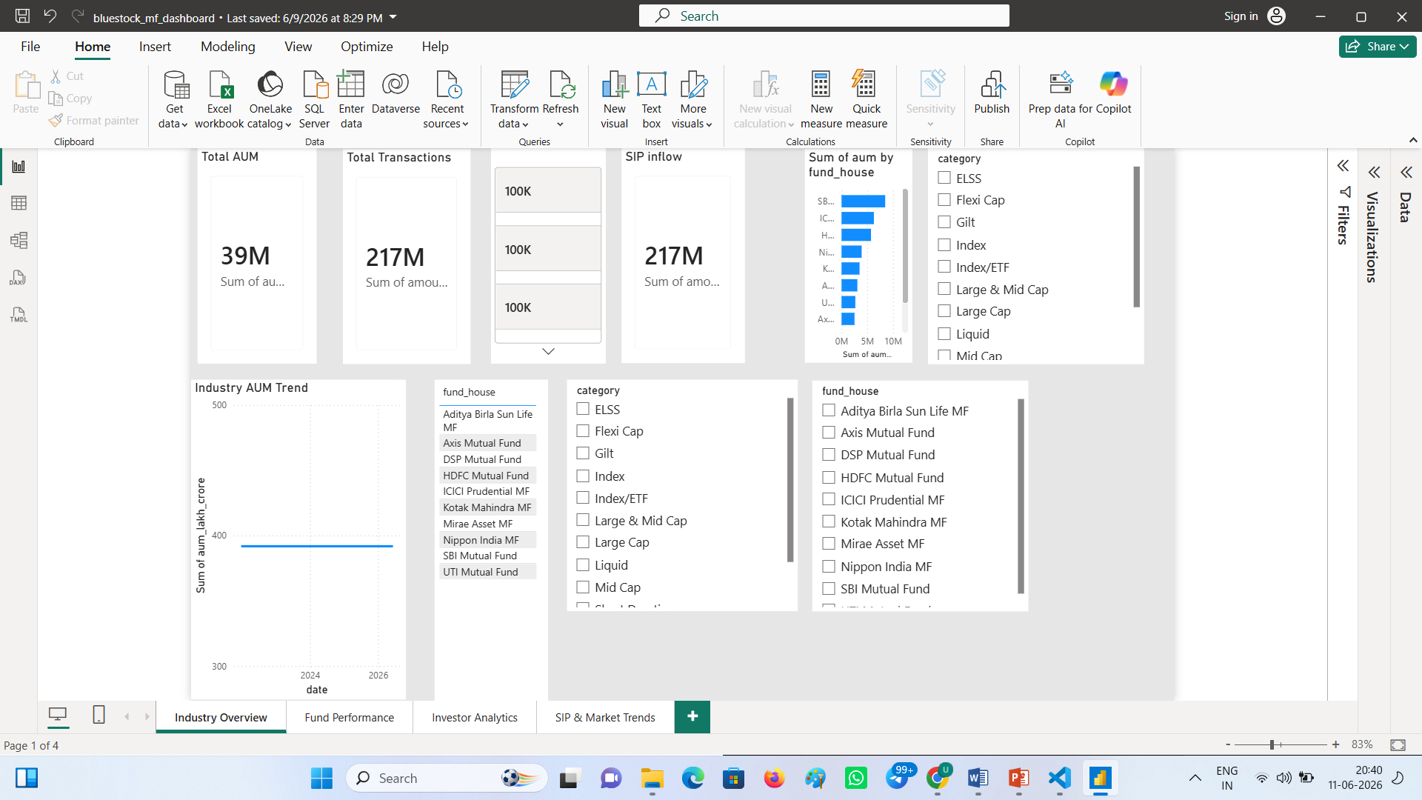
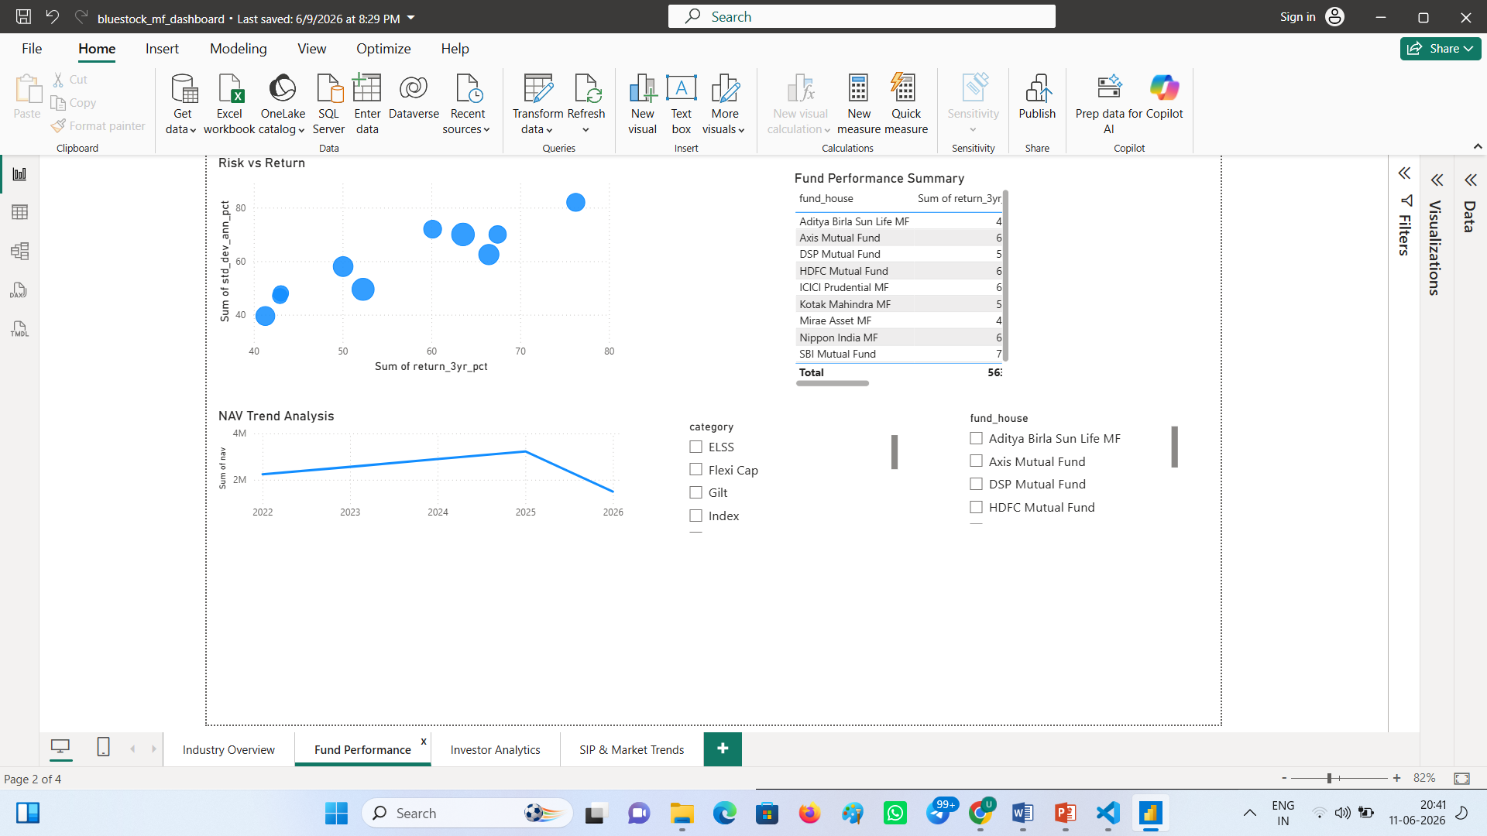
Dashboard Overview

Slide 10
Key Findings & Recommendations
Key Findings:
• High Sharpe Ratio funds delivered better risk-adjusted returns.
• Recent investor cohorts invested larger amounts.
• SIP continuity analysis identified at-risk investors.
• Dashboard enabled efficient performance monitoring.
Recommendations:
• Prefer funds with strong Sharpe Ratios.
• Monitor SIP continuity regularly.
• Diversify investments across categories.
• Use dashboard insights for periodic review.

Slide 11
Thank You

